Slide 1
The Uniform Relocation Assistance and Real Property Acquisition Policies Act of 1970
Presenters: Tara Ellis and Sara Alexander

Slide 2
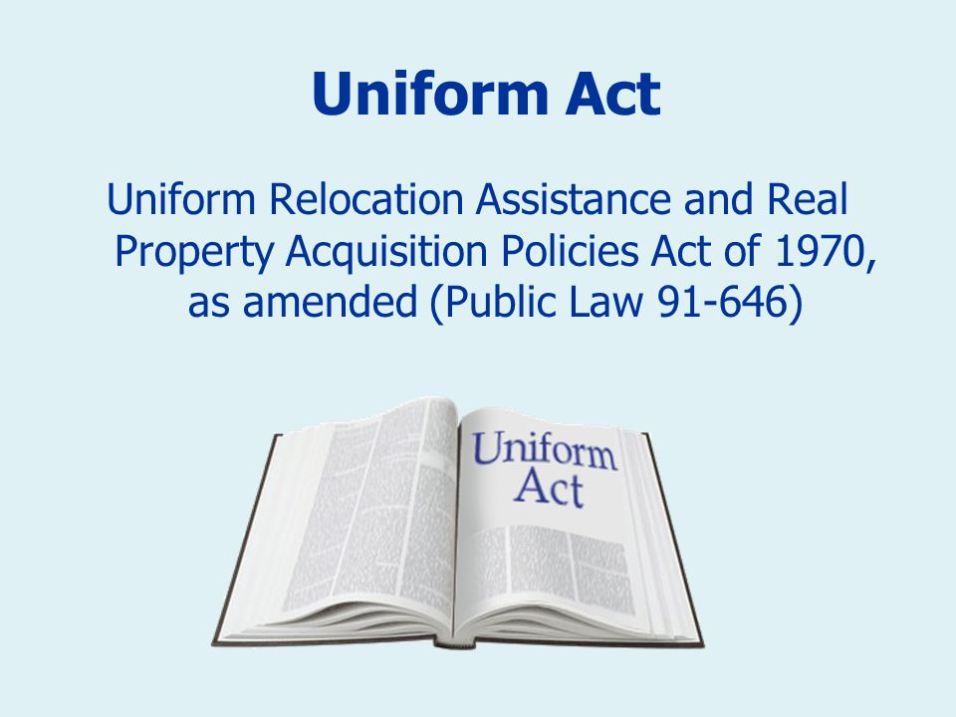
What is the URA?
The URA’s protections and assistance apply to the acquisition, rehabilitation or demolition of real property for federal or federally-funded projects.
The URA ensures that people whose real property is acquired, or who move as a direct result of such projects (“displaced persons”) are treated fairly and equitably and receive assistance in moving from the property they occupy.
49 CFR Part 24 is the government-wide regulation that implements the URA.
HUD Handbook 1378 provides HUD policy and guidance on implementing the URA for its programs and projects.

Slide 3
First, some definitions! 49 C.F.R. 24.2
A project is “. . . any activity or series of activities undertaken by a Federal Agency or with Federal financial assistance received or anticipated in any phase of an undertaking in accordance with the Federal funding Agency guidelines.”
A displaced person is “. . . any person who moves from the real property or moves his or her personal property from the real property.” [“As a direct result of a written notice of intent to acquire, rehabilitate, and/or demolish, the initiations of negotiations for, or the acquisition of, such real property in whole or in part for a project . . . or . . . such real property on which the person conducts a business or farm operation” or “As a direct result of rehabilitation or demolition for a project. ”] A person can be an individual, family, partnership, corporation, or association.
Federal financial assistance includes “. . . a grant, loan, or contribution provided by the United States, except any Federal guarantee, insurance or tax credits (Low Income Housing Tax Credit) and any interest reduction payment to an individual in connection with the purchase and occupancy of a residence by that individual.”

Slide 4
RIGHTS OF PERSON PERMANENTLY DISPLACED (residential)
Advisory Services
This includes the requirement to:
Explain relocation eligibility requirements, explain relocation services and payments, conduct personal interview to determine needs and preferences, provide appropriate services and payments.
Moving expense payments
Reimbursement of moving expenses to move their personal property. Can be paid on the actual cost of moving or the URA’s Fixed Residential Moving Cost Schedule, last updated August 26, 2021. (displaced person decides)
EX: URA MS Schedule
- 1 BD $750
- 2 BD $ 850
- 3 BD $1,000
- 4 BD $1,200
- 5 BD $1,400
Comparable replacement housing
Agencies must offer residential displaced persons comparable replacement housing before they can be required to vacate. Must be decent, safe, and sanitary (DSS)
Replacement housing payments (RHPs)
Homeowner-occupants and tenants may be eligible for a replacement housing payment (RHP).
Homeowner or tenant status determines the type of RHP a person may be eligible to receive.
90 day minimum written notice to vacate
Assures residential displaced persons a minimum of 90 days before they can be required to vacate the property.
For residential occupants, the 90-day period cannot begin until the person is offered a comparable replacement dwelling.
Housing of last resort
Whenever comparable replacement dwellings are not available within the URA monetary limits on RHPs, the displacing agency must provide housing of last resort assistance, which is typically most expensive.
Paying RHPs in excess of URA statutory limits is authorized and common.

Slide 5
TEMPORARY RESIDENTIAL RELOCATION
Temporary relocation
  Occupants are required to move for a limited amount of time – up to 12 months – to complete renovations or repairs to service systems.
  Although temporarily displaced persons do not receive the same relocation assistance and payments as persons permanently displaced under the URA, they do have certain rights and protections.
Fair and Reasonable
  Temporary relocation terms must be fair and reasonable. This includes offering suitable DSS replacement housing for the temporary period, reimbursement of all reasonable and necessary out-of-pocket expenses incurred in connection with the temporary relocation, and an offer to return to the project within 12 months.
Temporary Relocation Triggers
  Projects that trigger temporary relocation assistance:
    Require packing, moving, or storing residents’ furniture or personal items;
    Involve the unit’s kitchen or bathroom where the work prevents the use of these areas; or
    Create odors, dust, debris, noise, or other hazards.
  Projects that do NOT trigger temporary relocation:
    Short-term, temporary switch to new equipment, if the temperature within the unit can be maintained between 68-72 degrees Fahrenheit; or
    Short-term, temporary switch to new fixtures, receptacles, or equipment, if the electrical service to a unit is not interrupted.

Slide 6
RIGHTS OF PERSON TEMPORARY RELOCATED
(residential)
Notices
Reasonable Advance Notice to Vacate:
Relocation Advisory Services
At minimum, relocation advisory services must determine the needs of the displaced person, provide an explanation of available relocation assistance, and explain the displaced person’s right to appeal.
Displacement Assistance
Reasonable Unit Conditions
Must be DSS;
Must be suitable, but not necessarily comparable;
Term must be reasonable for costs and length of stay; and
Increased housing costs should not exceed the cost of the DSS temporary unit offered by the displacing agency.
HUD requires that a tenant be offered permanent displacement assistance if they will be displaced beyond 12 months. Tenants may be given the opportunity to:
Continue to remain temporarily relocated for an agreed period;
Permanently relocate to the unit which has been their temporary unit if it is available to do so; or
Choose to permanently relocate elsewhere with URA advisory services.
This includes the requirement to explain relocation eligibility requirements, explain relocation services, conduct personal interviews to determine needs and preferences, and provide appropriate services and payments.
Date and approximate duration of the temporary relocation;
Address of the suitable decent, safe, and sanitary dwelling to be made available for the temporary period;
Terms and conditions under which the tenant may lease and occupy a suitable decent, safe and sanitary dwelling in the building/complex upon completion of the project; and
Provisions of reimbursement for all reasonable out of pocket expenses incurred in connection with the temporary relocation as noted above.
Longer notice period may be appropriate for persons who will be temporarily relocated for an extended period or for persons who must move all personal property on-site.
Shorter notice period (hours or days) may be appropriate based on urgent needs due to danger, health or safety issues or if the person will be temporarily relocated for only a short period of time.
Reasonable advance written notice of the following:

Slide 7
What programs are subject to the URA?
Community Planning & Development
Community Development Block Grants (CDBG)
CDBG-Disaster Recovery
Section 108 Loan Guarantees
HOME Investment Partnerships Program (HOME)
Housing Trust Fund (HTF)
Homeless Assistance Programs
Public Housing
Choice Neighborhoods
Capital Fund Program
Project Based Voucher Program (PBV)
Housing
Rental Assistance Demonstration (AD)
Project Based Rental Assistance Program (PBRA)
If federal funds are used in any phase of a project, then URA requirements apply to all acquisitions of real property and relocation of persons for the project even if the funds are not used for the actual acquisition of the real property.

Slide 8
Scenarios!
Rehabilitation
ABC Park Apartments are being rehabilitated with federal funds.
Are those temporary or permanently relocated due to the rehabilitation entitled to protections under the URA?
What if the funds are used only to fund architectural and engineering costs?
New Construction
ABC Housing is planning to use HOME funds to construct a multifamily project.
If land (vacant or otherwise) is acquired for any phase of the project, is the acquisition subject to the URA?
What if the funds are not used for the actual purchase?
Public Improvements
ABC City is using CDBG funds for stormwater improvements.
Is the acquisition of easements for the project subject to the URA?

Slide 9

The FHWA is the lead federal agency that creates and maintains federal regulations that implement the URA.
HUD coordinates closely with the FHWA on URA matters to ensure HUD programs and projects that are subject to its regulations are considered before implementing final rules that amend the URA.

Slide 10

2024 FHWA FINAL RULE
Changes to the regulations were necessitated in part by the Moving Ahead for Progress in the 21st Century Act (MAP-21), enacted in 2012.
Increased benefit levels for displaced persons to account for inflation (resulting in a 33% increase in assistance).
Now permits other certified mail options, as well as electronic delivery of notices, and allows property owners to designate an authorized representative to receive notifications on their behalf.
Increased waiver valuation thresholds for property acquisitions with an estimated fair market value from $10,000 to $15,000 for the first tier and $25,000 to $35,000 for the second tier. 46 CFR 24.102(c)(2).
Enhanced relocation planning by federal agencies to better plan projects, be more proactive in identifying potential challenges, and streamline solutions/reduce disruptions for displaced families and businesses.
Rental replacement dwelling application fees or credit reports required to lease a replacement dwelling now clearly constitute moving expenses that are eligible for reimbursement (up to $1,000).
Previously, persons who were temporarily relocated (less than one year of relocation from a project site) were not considered under the definition of “displaced person.”
Updates include temporarily relocated persons under the definition of “displaced person” and provide clarity on administering URA relocation assistance to these persons.

Slide 11
Voluntary or Involuntary Acquisition of Property
HUD funded projects sometimes require the acquisition of real property by voluntary or involuntary means.
Under the URA, an acquisition is considered involuntary when an agency acquires property under threat or use of eminent domain.
Only involuntary acquisitions trigger the full acquisition requirements, while voluntary acquisitions do not.

Slide 12
What makes a transaction “voluntary”?
For agencies with eminent domain authority, if:
For agencies without eminent domain authority, if:
No specific site is needed and any of several properties could be acquired for project purposes;
The property is not part of an intended, planned or designated project area where other properties will be acquired within specific time limits;
The agency informs the owner in writing of the property's market value; and
The agency also informs the owner in writing that the property will not be acquired through condemnation if negotiations do not reach an amicable agreement.
*If tenants are displaced, they are provided relocation assistance.
The agency notifies the owner in writing of the property's market value; and
The agency notifies the owner prior to making an offer that it will not acquire property if an amicable settlement cannot be reached.
*If tenants are displaced, they are provided relocation assistance.

Slide 13
REAL PROPERTY ACQUISITION
*does not apply to voluntary acquisitions *
For example, properties that are for sale on the open market or if no specific property is needed to be acquired for the project.
See 49 CFR Part 24.101 for other circumstances.
Appraisal
The URA specifies a process to accomplish the standard of paying just compensation as required by the Constitution. A qualified appraiser must estimate the fair market value of the property throughout the appraisal process.
Review Appraisal
The appraisal must be reviewed by a qualified review appraiser for consistency and reasonableness, and to ensure it meets all standards.
Just compensation
Agencies must establish the amount of just compensation to offer the property owner, which cannot be less than the approved appraisal amount. An authorized agency employee must set the amount to be offered.
Written Offer
Agencies must make a written offer to the property owner for the just compensation amount. A verbal offer does not meet the URA requirements.
Negotiations
After the agency makes the offer, a reasonable period of negotiations should occur where the property owner can review the offer, ask questions, accept or reject the offer, or make a counteroffer. Agencies may pay more than the amount established by using an administrative settlement if it is reasonable, prudent, and in the public’s interest.
YES
If negotiations are successful, you proceed to closing.
NO
If negotiations are not successful, agencies with eminent domain authority may choose condemnation, but agencies without it must walk away.

Slide 14
Appraisals Must Contain 49 CFR 24.103
An adequate description of physical characteristics, personal property, a statement of known and observed encumbrances, if any, title information, location, zoning, present use, an analysis of highest and best use, and a five-year sales history.
All relevant and reliable approaches of value.
A description of comparable sales including a description of all relevant physical, legal, and economic factors such as parties to the transaction, source and method of financing, and verification by a party involved in the transaction.
A statement of the appraised value of the property.
The effective date of valuation, appraisal date, signature, and appraiser certification.

Slide 15
Recently monitored appraisals by HUD were missing:
A five-year sales history of the property (usually only three are shown).
Title information (title document not made available).
A statement of known and observed encumbrances (not shown, if none, then state so).
For comparable sales: The parties to the transaction, verification of the purchase price by a party involved in the transaction, and source and method of financing (not shown).

Slide 16
Appraisal Not Required 49 CFR 24.102(c)(2)
Not required if:
The owner is donating the property and releases the agency from its obligation to appraiser; or
It is determined it is unnecessary to appraise due to the low-market value and the acquisition will not be complex.
Estimated at $15,000 or less based on available data, but if owner is given opportunity to appraise, this can be raised up to $35,000.
If appraisal is unnecessary, then a waiver evaluation is necessary unless the owner elects to do an appraisal.
Waivers are not appraisals.
The individual conducting the waiver valuation must have a sufficient understanding of appraisal principles to interpret and understand local market indicators for preparing the waiver valuation.
A waiver valuation does not require the property owner be offered the right to accompany the person doing the waiver valuation during any inspection of the property nor a formal appraisal review.

Slide 17
The Relocation Process
1. Send the applicable General Information Notice (GIN) to all occupants when at such time there is an identified site for the project and a submitted application for HUD program funds. Failure to issue GIN as soon as feasible may result in unintended displacements and URA relocation payments.
2. Conduct tenant interviews and gather appropriate documentation to determine which occupants will be displaced and those that will not be. Prepare cost estimate for those temporary or permanently relocated and submit a Relocation Plan.
3. Send required Notice of Eligibility to all occupants on the applicable “Initiation of Negotiations” date, which is typically the date of execution of the grant agreement.

Slide 18
Notices 49 CFR 24.5
General Information Notice
It informs affected persons of the project and that they may be displaced by the project.
Notice of Eligibility
Informs persons they will be displaced or will not be displaced by the project and establishes what they are eligible for.
90-Day Notice
Informs displaced persons of the earliest date they will be required to move. It cannot be issued unless a comparable replacement dwelling is available, the displaced persons are informed of its location, and the displaced persons have sufficient time to lease or purchase it.
30 day Notice to Vacate, if applicable
If person is temporarily relocated for a period of up to 12 months.
Types of Notices
Recommended minimum 30-day notice for temporary relocation.
  Not required to move or move is less than 12 months.
  Not rent burdened, i.e. no economic displacement.
  Not under-housed, i.e. suitable number of occupants per unit.
  Meets all occupancy criteria of development upon completion.
  Payments of increased costs.

Slide 19
General Information Notice (GIN)
Informs the person of:
  Possible displacement and generally describes relocation payment(s) that may be available and procedures for obtaining payment. 49 CFR 24.203(a)(1).
  That reasonable relocation advisory services will be given, including referrals to replacement properties, help in filing payment claims, and other necessary assistance to help relocation. 49 CFR 24.203(a)(2).
  That no one will be required to move without at least 90 days’ advance written notice and that they cannot be required to move permanently unless at least one comparable replacement dwelling has been made available. 49 CFR 24.203(a)(3).
  Anyone who is an alien not lawfully present is ineligible for relocation advisory services and relocation payments, unless such ineligibility would result in exceptional and extremely unusual hardship to a qualifying spouse, parent, or child. 49 CFR 24.203(a)(5).
  Their right to appeal the program participant’s determination as to the person’s application for assistance. 49 CFR 24.203(a)(5).

Slide 20
Notice of Eligibility
49 CFR 24.9 and 49 CFR 24.203(b)
Permanent Relocation
Temporary Relocation
Must inform the person of their eligibility for relocation assistance effective on the earlier date of a notice of intent to acquire, the initiation of negotiations, or actual acquisition. 49 CFR 24.203(b).
Adequately describe the assistance, the estimated amount of assistance and the procedure for obtaining the assistance. 49 CFR 24.203(b).
Correctly explain the moving expenses choices available. 49 CFR 24.203(b).
  Actual Expenses. 49 CFR 24.301.
  Fixed Payment. 49 CFR 24.302.
  Self-Move. 49 CFR 24.301(b)(2).
Issue a 90-day notice to vacate no earlier than the Notice of Eligibility.
Guarantees a unit will be available under reasonable terms.
The unit will meet all Decent, Safe, and Sanitary criteria and rent will not be unreasonably increased under applicable regulations.
Identify the location(s) of available DSS temporary units.
Payments of all actual and reasonable moving expenses and increased monthly housing costs if moving temporarily.
  Fixed moving payments not allowed.
If necessary, issue a minimum 30-day notice to vacate.
Not eligible for other relocation assistance.
  Still required to pay rent and comply with other lease terms.

Slide 21
REMINDERS
49 CFR 24.10 requires the Agency to promptly review appeals if any aggrieved person files a written appeal in any case in which the person believes that the Agency has failed to properly consider the person’s application for assistance. Such assistance may include, but is not limited to, the person’s eligibility for, or the amount of, the payment to the previous owner or the relocation payment.
49 CFR 207(f) of the URA regulations requires that a displacing agency can not propose or request that a displaced person waive his or her rights or entitlements to relocation assistance and benefits provided by the Act.
Any person who qualifies as a displaced person must be fully informed of his or her rights and entitlement to relocation assistance and payments provided by the Uniform Act.
Furthermore, to minimize unintended displacement, its HUD’s policy to consider all occupants in the proposed HUD assisted project involving an acquisition, rehabilitation or demolition as scheduled to be displaced for purposes of issuing a GIN as described in Handbook 1378, chapter 2 section 2-3(B).

Slide 22
Comparable Replacement Dwelling
Displaced person must be notified in writing as soon as feasible of the specific comparable replacement dwelling and the price or rent/utility costs used for establishing the upper limit of the replacement housing. 49 CFR 24.205(c)(2)(ii)(B)
At least one and where possible, three or more comparable replacement dwelling(s), must be made available to the displaced person. 49 CFR 24.204(a) and 49 CFR 24.205(c)(2)(ii)(A).

Slide 23
Replacement Housing Payments
49 CFR 24.9 and 49 CFR 24.401-24.404, as applicable
A tenant who occupied the dwelling for at least 90 days immediately prior to either (i) initiation of negotiations for acquisition or (ii) displacement is generally entitled to receive rental replacement housing payment under the URA when permanently relocated.
The payment must be enough to allow the person to lease or rent a comparable replacement dwelling but cannot exceed $9,570 or 42 months (can be adjusted when deemed necessary by head of lead agency’s regulations).
In the event a tenant relocates by purchasing a home instead of continuing to rent, then such payment may be applied to a down payment on the purchase of the home so long as it is a decent, safe, and sanitary replacement dwelling.
It should be noted that such payments should be based on income levels for low-income persons.

Slide 24
Decent, Safe, and Sanitary (DSS)
49 CFR 24.2(a)(8) and 49 CFR 24.403(b)
The replacement unit must have been inspected and determined to be DSS prior to making a replacement housing payment or releasing the initial payment from escrow.
This means it:
  Meets local housing and occupancy codes;
  Is structurally sound, weather tight, and in good repair;
  Contains a heating system capable of reaching approximately 70 degrees, except in areas where conditions do not require such a system;
  Is adequate in size with respect to the number of rooms and area of living space needed to accomdate the displaced person;
  Contains a seperate, well lit and ventilated bathroom that provides privacy to the user and contains a sink, bathtub or shower, all in good working order and properly connected. The kitchen must contain a fully usable sink and adequate space for a stove and refrigerator;
  Contains unobstructed egress; and
  If disabled, be free of any barriers that would preclude reasonable ingress, egress, or use of dwelling.

Slide 25
Other Requirements
Minority persons given reasonable opportunities to relocate to decent, safe and sanitary replacement dwellings that are within their financial means and not located in an area of minority concentration. 49 CFR 24.205(c)(2)(ii)(D).
Displaced person offered transportation to inspect housing to which the person was referred. 49 CFR 24.205(c)(2)(ii)(E).
If eligible for government housing assistance at the replacement dwelling, was the person advised of any requirements of such government housing assistance program that would limit the size of the replacement dwelling, as well as of the long-term nature of such rent subsidy, and the limited (42 month) duration of the relocation rental assistance payment? 49 CFR 24.205(c)(2)(ii)(F).
Offered counseling and advice as to other sources of assistance that may be available provided, along with technical help to persons applying for such assistance. 49 CFR 24.205(c)(2)(iv) and 24.205(c)(2)(v).

Slide 26
RESIDENTIAL DISPLACEMENT
Provide relocation advisory services to displaced tenants and owner occupants
Provide a minimum 90 days’ written notice to vacate prior to requiring possession
Reimburse for moving expenses
Provide payments for the added cost of renting or purchasing comparable replacement housing
Remember, payment cannot exceed $9,570 or 42 months. But let’s say there is no comparable, DSS replacement housing available, and the lowest rental option is an extra $1,500 a month. Will an agency approve this payment for 12 months, which totals $18,000?

Slide 27
Nonresidential Relocation
Businesses, farms, and nonprofit organizations
In addition to relocation advisory services, nonresidential displaced persons may be eligible for other relocation assistance including relocation payments for moving expenses and reestablishment.
  Payment for the actual, reasonable moving costs and related expenses, and
  Payment for actual, reasonable reestablishment expenses or a fixed payment "in lieu of" moving and reestablishment costs.

Slide 28
NONRESIDENTIAL DISPLACEMENT
Provide relocation advisory services
Provide a minimum 90 days’ written notice to vacate prior to requiring possession
Reimburse for moving expenses and reestablishment expenses

Slide 29
Recordkeeping
All related documentation for compliance with the URA must be kept in the project file or submitted to HUD to clear any monitoring findings as necessary.
  Each displaced person must have a relocation file that must be maintained for at least 5 years after final project closeout, or after the person has received his/her final relocation payment, whichever is later.
When violations are found, agencies must take corrective actions in a timely manner to mitigate or remedy impacts to the displaced person.
Any corrective actions must be documented as well in the project file for all relocation cases.
It is recommended that such documentation be consistent with the recordkeeping requirements of Chapter 6 of HUD Handbook 1378.

Slide 30
RESIDENTIAL ANTIDISPLACEMENT AND RELOCATION ASSISTANCE PLAN (RARAP)
The Housing and Community Development Act of 1974 (the “Act”) (42 U.S.C. 5301 et seq.), as amended; and the U.S. Department of Housing and Urban Development (“HUD”) regulations at 24 CFR § 42.325 require certain agencies and developers to adopt a plan.
  i.e, a RARAP is required under for CDBG, UDAG, and/or HOME-assisted projects, but not for HTF projects.
  NOTE: Although a RARAP is not explicitly required under HTF Regulations, the HTF Regulations do require compliance with the Uniform Relocation Assistance and Real Property Acquisition Policies Act of 1970, as amended (“URA”) and 49 CFR Part 24. 24 CFR § 93.352(c).

Slide 31
HUD published a guide for its reviewers (Relocation Specialists) to use when monitoring a program participant’s policies and procedures relating to the URA, so keep these questions in mind as you are creating your RARAP.

Slide 32
For CDBG and HOME reviews, does the program participant have a Residential Anti-displacement and Relocation Assistance Plan (RARAP) and is the program participant following the plan? 24 CFR 42.325(a); CDBG: 24 CFR 570.606(c); HOME 24 CFR 92.353(e).
Does the Consolidated Plan contain definitions of “standard condition” and “substandard condition suitable for rehabilitation?” 24 CFR 42.305 and 24 CFR 91.205(b)(1)(ii) or 91.305(b)(ii).
CDBG & HOME only: If the program participant provides optional relocation assistance not required by State or local law, has an Optional Relocation Policy been adopted that is available to the public and provides for equal relocation assistance within each class of displaced persons? 24 CFR 92.353(d) or 24 CFR 570.606(d).
Do the program participant’s policies and procedures require notices of funding availability and requests for proposals (or the equivalent) to inform applicants of acquisition and relocation-related actions that, if applicable, must take place prior to award (e.g., notice to owner, GIN issuance, tenant tracking, and (where applicable) identification of comparable replacement units)?
Do the program participant’s policies and procedures request or require relocation plans for occupied projects (not required by regulation, but should be on file if part of the program participant’s policies)?

Slide 33
Does the program participant have procedures in place to require all persons seeking URA relocation payments or advisory assistance to certify that they are lawfully present in the United States? 49 CFR 24.208.
Do the program participant’s subrecipient agreements and loan/grant agreements explicitly require compliance with URA/104(d) requirements, including reporting and recordkeeping? 2 CFR 200.331(a)(2).
Do the program participant’s procedures specify a process for reviewing relocation claims for cost allowability and for requiring that each replacement housing unit passes a decent, safe and sanitary (DSS) inspection prior to issuance of a Replacement Housing Payment (RHP)?
Do the program participant’s policies/procedures identify a process for distributing residential relocation payments in a manner that complies with the prohibition against lump sum disbursements (except for moving expenses, down payment on the purchase of a replacement dwelling, or incidental expenses related to such moving expenses or down payment)? 42 U.S.C. § 3537c.

Slide 34
Does the program participant have procedures in place to require appeals to be processed in compliance with URA requirements? 49 CFR 24.10.
Is there a system for tracking and documenting required acquisition and relocation actions? 49 CFR 24.9.
Does the program participant’s policies and procedures require that activities undertaken by subrecipients are monitored? 2 CFR 200.331(d).
What process does the program participant have to determine subrecipients’ technical assistance and training needs, if any?

Slide 35
Let’s Walk Through HUD’s Guideform Plan

Slide 36
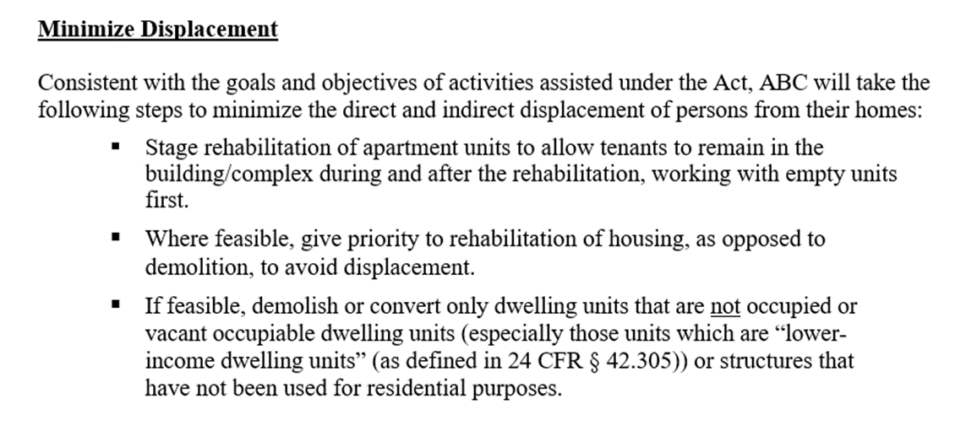
NOTE: These steps are just examples. HUD offers additional options, and each jurisdiction must determine which actions it will take based on local needs and priorities.
Other examples:
  Evaluate housing codes and rehabilitation standards to prevent undue financial burden.
  Arrange for facilities to house persons who must be relocated temporarily during rehabilitation.
  Adopt tax assessment policies, such as deferred tax payment plans, to reduce impact of increasing property tax assessment on lower income owner-occupants or tenants in revitalizing areas.
  Target only those properties deemed essential to the need or success of the project.

Slide 37
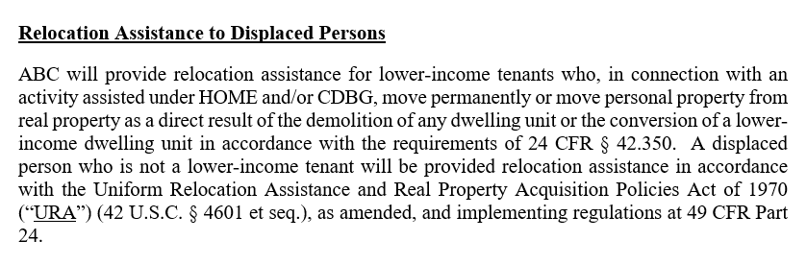

Slide 38
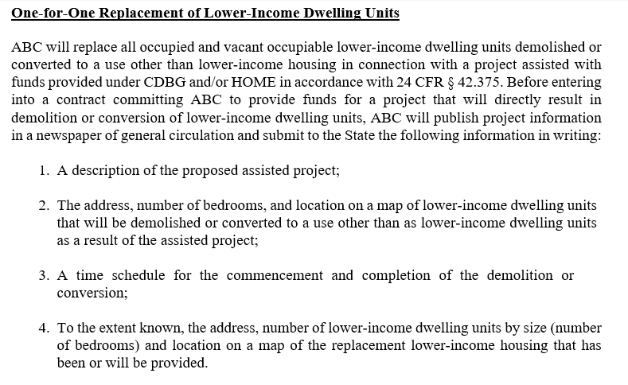
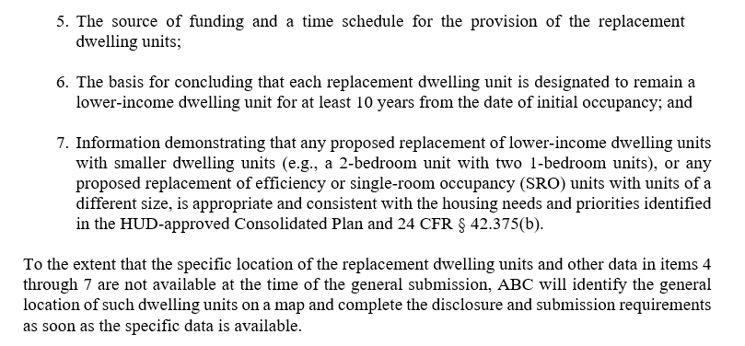

Slide 39
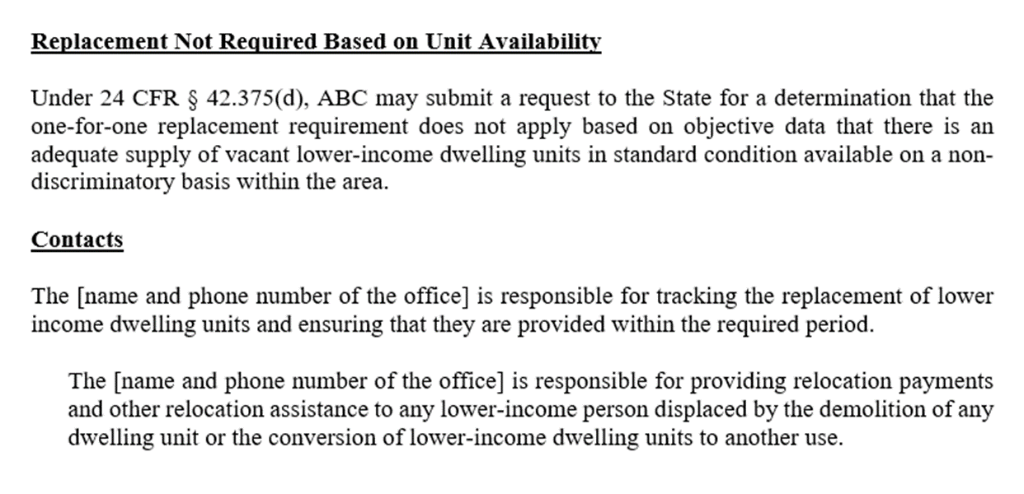
*This section assumes “ABC” is funded by the state. If not funded by the state, then submission goes to HUD.

Slide 40
Common Compliance Issues
Not receiving adequate notice.
Untimely relocation assistance.
Inaccurate moving payments or replacement housing payments.
Not complying with the URA appraisal process for:
  Determining when an appraisal is not required.
  Establishing written appraiser qualification standards.
  Completing appraisals that contain all the required elements.

Slide 41
Possible Consequences of Non-Compliance
Recission of any previous approval(s), and HUD will inform other Federal agencies of the noncompliance.
Seller has choice to avoid or affirm a purchase option or contract for an acquisition that was entered into when all requirements have not yet been satisfied and may negotiate a new agreement if desired.
Responsible to compensate property owner for any reasonable expenses, such as attorney fees, appraisal fees, and engineering fees, when incurred because of unlawful condemnation.
Reprogramming of funds not yet expended from the affected activities to other eligible activities.
Suspending disbursement of funds.

Slide 42
Correctable Violations
Inadequate Financial Assistance
Inadequate Replacement Housing
Person has not received the full amount of payment(s) he/she is entitled to.
Agency must pay the difference between the required payment(s) and the actual payment(s) made to the displaced person.
Person has relocated to housing that does not meet decent, safe, and sanitary standards (DSS).
Agency must assist the person in relocating to a new dwelling that is DSS or take action to correct their current housing to be DSS.

Slide 43
Corrective Action
How are URA benefits calculated when a displaced person is found and determined to be eligible?
What should you do if former occupants move from the project without the appropriate URA requirements or benefits?
Responsible for paying the appropriate moving and related costs from their initial move from the dwelling and possible subsequent moving and related payments if they must move again (current dwelling is not DSS).
If eligible for RHP, the calculation is a point-in-time calculation using housing costs, gross income, and household composition as of the applicable date.
Locate the displaced persons and provide the required URA assistance and benefits.
Have a duty to make all reasonable efforts to obtain records and contact information of persons displaced.
If information is not available or cannot be reasonably obtained, then:
  Place notice in local newspaper for at least 30 days;
  Post a notice in appropriate project location(s);
  Check with local post offices for a forwarding address;
  Inquire with local utility companies, school districts, churches, or community organizations;
  Examine project records for any contact information;
  Hire a servicer to help locate such persons or conduct social media and internet searches; and
  All other appropriate methods on a case-by-case basis.

Slide 44


PRESENTERS
Partner, Jackson
PArtner, Jackson
Tara Pierre Ellis
Sara Alexander
tellis@balch.com
salexander@balch.com

Slide 45
Thank You!
Stay connected with Balch & Bingham

